Slide 1

Inequalities in prevalence of at least one Long Term Condition (LTC) in Bedfordshire, Luton and Milton Keynes (BLMK)
July 2025
blmkicb.phiu@nhs.net

Slide 2
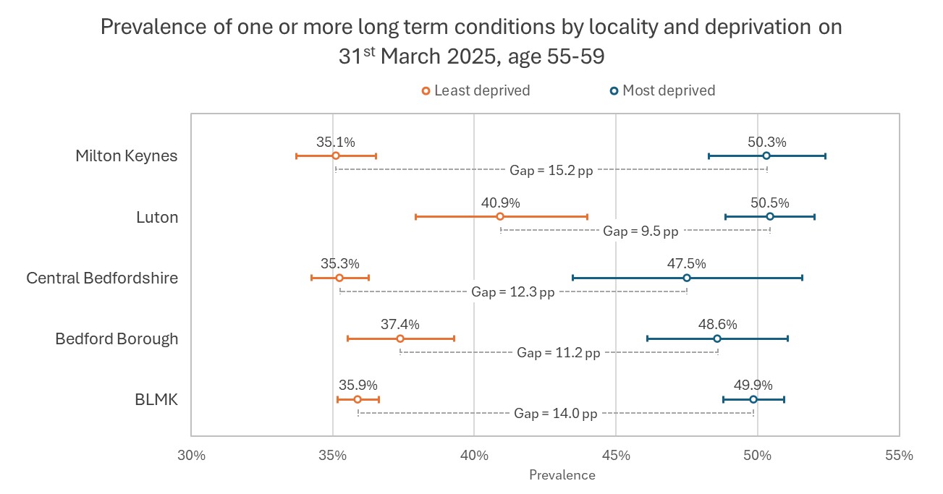
New insights into health inequality in BLMK
The PHIU have developed a new approach to measuring health inequality, comparing prevalence of at least one long term condition (LTC) between our most and least deprived areas.
We see large differences in health across our communities with this new measure.
At ages 55-59, people living in our 20% most deprived communities have a much higher prevalence of at least one LTC than people in our 20% least deprived areas (this difference is statistically significant in all areas).
Across BLMK as a whole, 35.9% of people in our least deprived areas have at least one LTC by the age of 55-59, but in the most deprived areas this rate is much higher at 49.9% (a 14 percentage point gap, or more than an additional person out of every ten).
1. The chart shows prevalence of at least one long term condition on 31st March 2025. The coloured bars show 95% confidence intervals for each place and deprivation quintile. The gap is calculated as the difference between the rates for the 20% most and least deprived (most deprived prevalence – least deprived prevalence = gap) and measured in percentage points (pp).
2. Not all LTCs are included in this data. It includes the conditions covered by QOF registers (except depression and asthma) and uses the same definitions.
Source: AGEM DME, 2025

Slide 3
New insights into health inequality in BLMK
What this tells us
Across BLMK and all its places, there is a large and statistically significant gap between the most and least deprived areas in terms of prevalence of at least one long term condition.
Differences by Place
Gaps: Milton Keynes has the largest inequality gap (15.2 percentage points) and Luton has the smallest gap (9.5 percentage points)
Overall, prevalence is highest in Luton and lowest in Milton Keynes, and this is the case in both the most and the least deprived areas.
What else we can do with this approach
This method could be applied to ethnicities, GP practices, comparing people with and without learning disabilities or any other characteristic that we have data for.
Tracking population health inequalities
We intend to run the study annually to track changes in health inequalities.

Slide 4
New insights into health inequality in BLMK
Why we chose this approach
We attempted many ways of slicing the data. The prevalence of at least one long term condition was agreed upon as it is simple to understand and uses common definitions taken from the QOF registers.
Using five-year age bands allows a sample size large enough for significant differences in prevalence rates to be identified. It also allows annual tracking of the measure as each year as the 55–59 years old cohort will be slightly different as patients age into and out of that band. It minimises the impact of the different age structures in the populations of our four Places.
The 55-59 age band was chosen as this was where we observed the largest absolute differences in prevalence.
Not all possible LTCs are included
There is no agreed set of long-term conditions. We capture a broad range of some of the most common LTCs using conditions in the QOF clinical domain. We excluded asthma because rates are very high, and also because we observed a paradoxical effect where asthma prevalence according to the QOF definition (which requires a recent prescription) is higher in the least deprived areas among young adults. We believe this is due to deprivation-linked differences in patients’ ability to afford asthma medication prescriptions. Depression was excluded because the high number of people with the condition skewed the results.
The LTCs:
Atrial fibrillation, cancer, chronic kidney disease, COPD, coronary heart disease, dementia, diabetes mellitus, epilepsy, heart failure, hypertension, osteoporosis, peripheral arterial disease, rheumatoid arthritis, schizophrenia, bipolar affective disorder and other psychoses and other patients on lithium therapy, stroke or TIA.

Slide 5
Methodology (summary)
We searched for SNOMED diagnostic and resolution codes included in the NHS Primary Care Database Reference Dataset for all the conditions included.
For conditions requiring a medication to be included in QOF registers (Lithium therapy and Epilepsy), we searched for prescriptions showing that a person had been prescribed medication to treat their condition.
If a condition for a specific patient had a resolved status with no subsequent re-diagnosis, the condition for that patient was removed from our results.
We applied the minimum age rules where specified by QOF.
IMD quintiles are based on where the patient is living at the date of the study (31st March 2025).
We calculated prevalence as the number of people with at least one LTC divided by the total population of each segment. Wilson confidence intervals were used as recommended by the Office for Health Improvement and Disparities (OHID).
We used information from AGEM DME ( Data Management Environment) as a data source for this project.

Slide 6
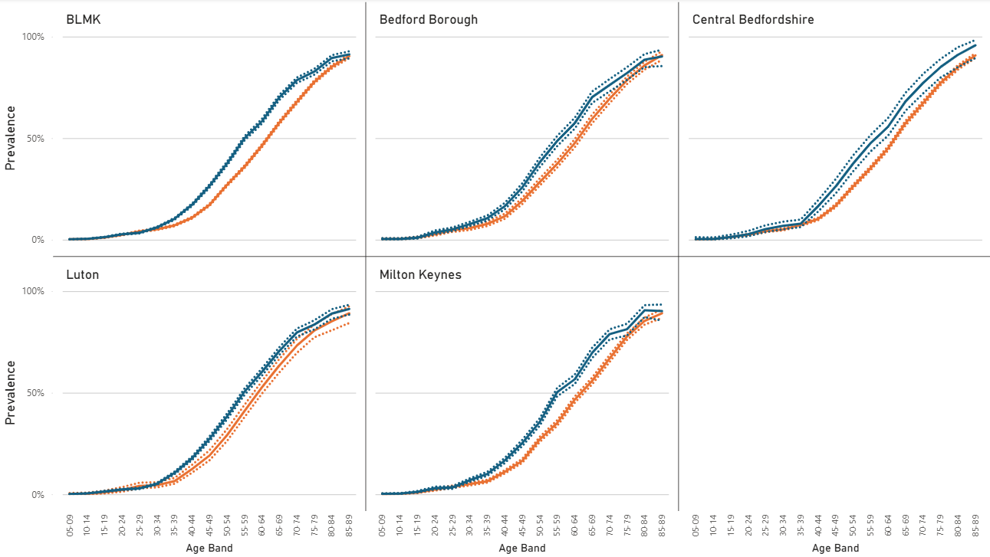
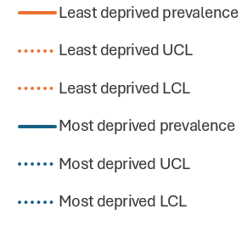
Prevalence of at least one LTC across all age bands

