Slide 1
CYP data pack
BLMK Indicators
Produced by the Population Health Intelligence Unit

Slide 2
Start Well context
We have an ambitious plan for our 250,000 children set out in our BLMK integrated care system health and care strategy – To ensure every child has a strong healthy start to life. This is further built on in our BLMK ICB Joint Forward Plan and taken forward in our Place based plans, enabled by our System partnership working.
Many children are waiting too long to see services for early identification, support and diagnosis and the impact this time has on a child’s developmental progress and opportunity to thrive.
We know our longest waits in community services are for children waiting for an assessment of neurodiversity and in community mental health services children waiting for treatment to start.
Across our local authorities we have also seen a substantial increase in requests for ECHP’s and shift with requests being made for much younger children then pre pandemic referrals
We know we have improved on closing the gap between children and adults waiting times in Acutes electives, we know after general paeds ENT and Orthodontics are our 2 longest waits specialities.
We know there is an increase in children presenting with more complex needs and with higher acuity.

Slide 3
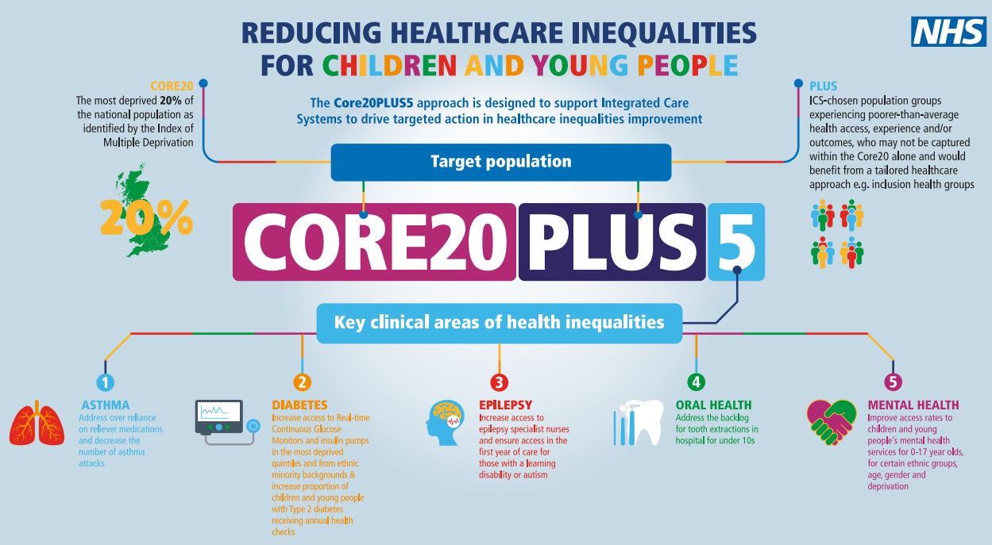

Slide 4
Contents
1
Population Overview
5
Health and Wellbeing
2
Pregnancy and Birth
6
SEND
3
Protecting Health in Infancy
7
Mental health
4
School Readiness
8
Educational attainment

Slide 5
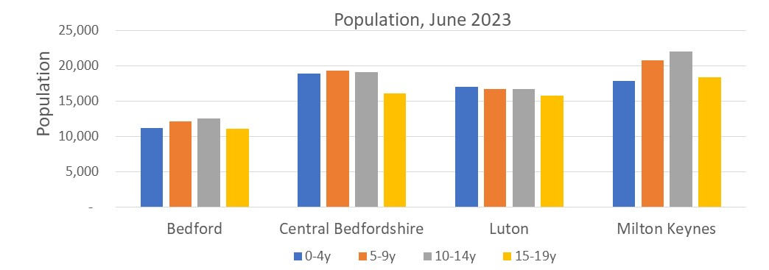
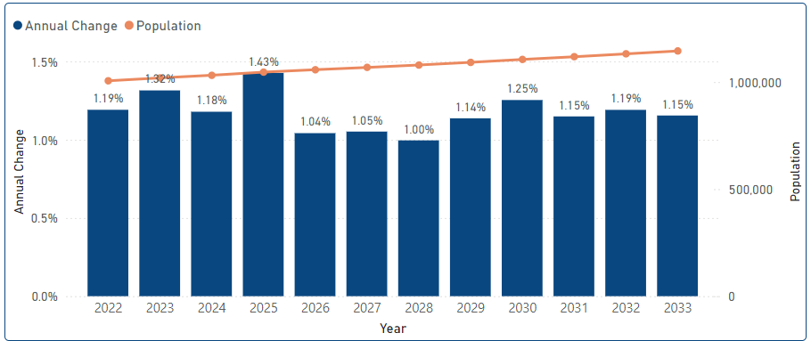
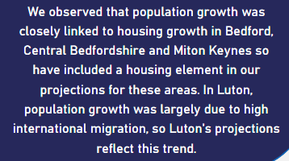
Population Overview
1

Slide 6
CYP population pyramid
Notes:
Numbers decrease between the ages of about 19 to 24y except Luton
https://www.yhphnetwork.co.uk/links-and-resources/useful-links-resources/the-life-course/

Slide 7
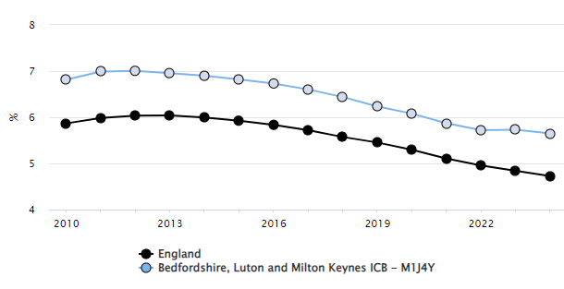
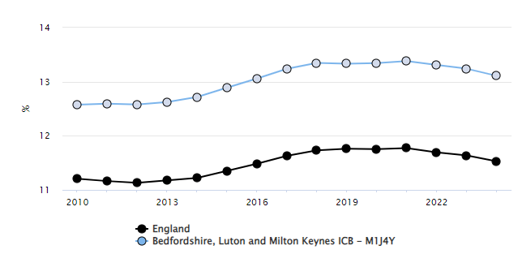
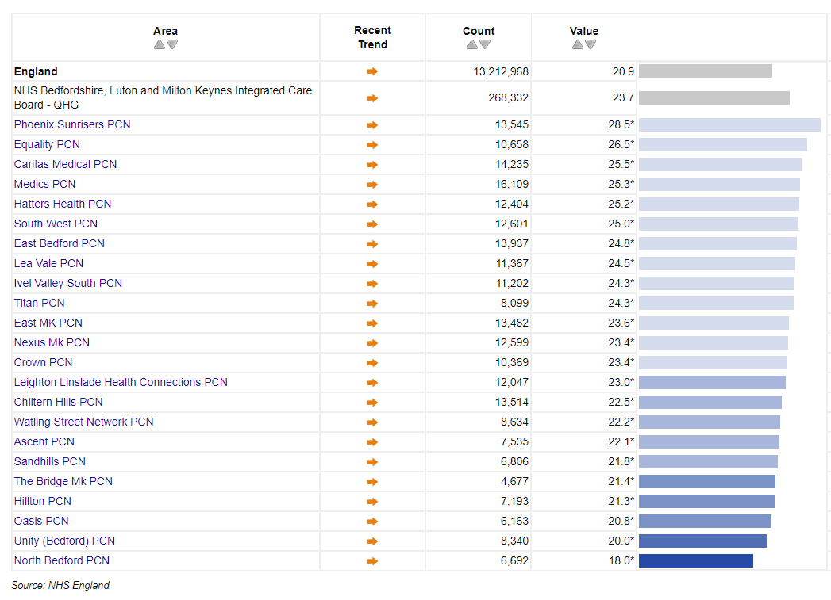
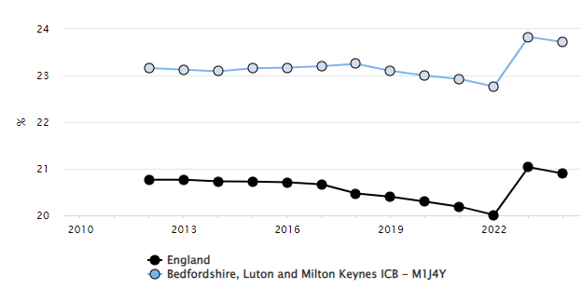
Populations by age group in BLMK
Proportion of 0-4 age group in BLMK
Proportion of 5-14 yrs age group in BLMK
The proportion of the population in CYP age groups is higher in BLMK than in England overall.
Proportion of under 18’s by PCN in BLMK
Proportion of under 18’s in BLMK

Slide 8




Pregnancy and Births
2
Context
Women from minority ethnic groups more likely to die during or soon after their pregnancy ends, when compared to white women. Stillbirths and infant deaths are also higher among some ethnic minority groups. [4]
Low birthweight can have an impact on infant morbidity and mortality as well as consequences for health later in life. Additionally, the occurrence of low birthweight are socially unequal across England.
Births to teenage mothers have higher rates of infant mortality, and children to teenage mothers are more likely to live in poverty, poor quality housing and have accidents or behavioural problems.[5]
Deliveries from ethnic minority groups
Low birth weight babies
Summary
Deliveries to women from minority ethnicities is higher in BLMK than both England and East of England. With Luton nearly twice the BLMK average at 59.9% and Central Bedfordshire less than half at 12.2%.
Low birthweight deliveries for BLMK are significantly higher than England driven mostly by Luton which is the only place that is significantly higher at 9.1%.
Births to teenage mothers are slightly lower in BLMK and East of England compared to the national average. There is not much variation between place level rates.
1 in 3 (33.4%) deliveries are to women from minority ethnic groups in BLMK.
This compares to 16.4% for the East of England and 22.9% nationally.
1 in 13 (7.5%) of all deliveries were of low birth weight in BLMK.
This compares to 6.3% for the East of England and 6.8% nationally.

Slide 9
Protecting Health in Infancy
3
Context
Child development recognisable two and a half years has an impact by the time children enter school. Inequalities are also observed with deprivation.
New birth visits are important for continuing support and identity early developmental needs and promote healthy parenting advice. Early interventions may be more successful.
The recommended target for MMR vaccination coverage is 95% for the first dose and 95% for the second at any point up to 5 years, to prevent measles outbreaks.
Vaccination coverage for BLMK
MMR both doses 5y
HPV Female 1 dose
12-13y
HPV Male 1 doses 12-13y
MMR Dose 1 2y
MMR Dose 2 5y
Goal
Goal
Goal
89.9%
92.1%
86.1%
93.6%
52.9%
60.0%
93.6%
<80%
<90%
<80%
≥ 95%
≥ 90%
≥ 90%
Second dose MMR vaccination coverage is 86.1% and below the 90% target for BLMK.
This compares to 89.2% for 84.5% nationally.
The first dose HPV coverage in females is 60.0% and in males is 52.9%, both below the 80% target for BLMK. This compares to 71.3% and 65.2% respectively for the national figure.
Summary
Luton had lower results than target for MMR vaccination & all LAs in BLMK for HPV.
33.2%
Notes:
Population vaccination coverage: Flu (primary school aged children)

Slide 10




School Readiness
4
Context
Good level of development is a key measure of early years development across a wide range of developmental areas.
Children from poorer backgrounds are at risk of slower development and the evidence shows that differences by social background emerge early in life. Free school meal eligibility (FSM) is an indicator of this and has been included here to show to differences in outcomes for this group.
Development at 2-2.5y
School readiness- end of Reception
Good level of development
Good level of development
Good level of development (FSM)
Summary
Roughly 1 in 5 pupils across BLMK are eligible for free school meals.
In this group, less than half are reaching a good level of development compared to 66.5% overall.
76.7%
66.5%
50.4%
BLMK compares to 84.7% for the East of England and 79.2% for England.
This compares to 67.7% for the East of England and 67.2% nationally.
This compares to 48.6% for the East of England and 51.6% nationally.

Slide 11
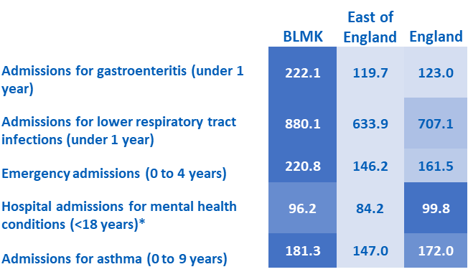


Health and Wellbeing
5
Context
There are significant health consequences to childhood obesity, both physical and mental, which are more likely to persist into adulthood.
Poor oral health is a priority under Best Start in Life and children experiencing poor health including oral health can negatively impact their ability to learn and develop.
Gastroenteritis and lower respiratory admissions indicate success in parenting practices and other management of symptoms outside of hospital.
Emergency hospital admissions can indicate wider determinants of poor health such as housing, damp and transport. With 1 in 4 admissions being related to respiratory infections.
With 1 in 10 children aged 5-16 having a diagnosable mental health condition, emergency admissions for under 18s can indicate the burden of poor mental health.
Overweight and obesity
Hospital admissions
1 in 5 (19.0%) reception children are overweight or obese in BLMK.
This compares to 20.0% for the East of England and 21.3% nationally.
2 in 5 (36.8%) year 6 children are overweight or obese in BLMK.
This compares to 34.3% for the East of England and 36.6% nationally.
Summary
All hospital admissions shown are notably higher in LBC, except for mental health admissions. All places have admissions significantly higher than England for Emergency admissions and all places except BBC are significantly higher than England for gastrointestinal and lower respiratory admissions
Childhood obesity rates in BLMK are roughly twice as high by the time children are in year 6, and the obesity rates of year 6 children is rising across England. CBC has a lower prevalence at both reception and year 6 while LBC has a higher rate among year 6 compared to the other places.
Visually obvious dental decay is varied in BLMK with LBC being significantly higher than national and CBC and MKC being significantly lower.
Dental
BLMK experiences higher admissions for gastroenteritis, lower respiratory, emergency admissions and asthma compared to East of England and England.
*Admissions for mental health condition will mostly represent teenage children.
50.7%
1 in 4 (23.6%) 5-year-olds experience visually obvious dental decay in BLMK.
This compares to 19.3% for the East of England and 23.7% nationally.
Notes:
https://fingertips.phe.org.uk/search/oral%20health#page/6/gid/1938133263/pat/159/par/K02000001/ati/15/are/E92000001/iid/93563/age/34/sex/4/cat/-1/ctp/-1/yrr/1/cid/4/tbm/1

Slide 12
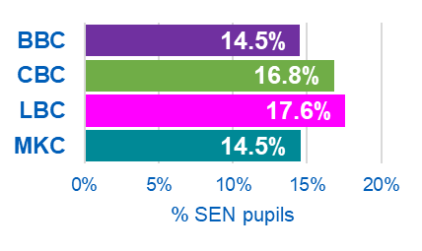
SEND
6
SEN pupils
Attainment
Context
“All children are entitled to an education that enables them to achieve the best possible educational and other outcomes, and become confident young children with a growing ability to communicate their own views and ready to make the transition into compulsory education.” [10]
Children with special educational needs and disabilities (SEND) experience worse outcomes than their peers, in terms of attendance and educational attainment. They experience poorer health outcomes and often have less opportunities later in life. [10]
+2,610
1 in 6 (15.9%) pupils have SEN (EHC plan or SEN support) in BLMK.
This compares to 16.3% for the East of England and 17.1% nationally.
Of this 15.9%, 4.2% are EHC plans and 11.7% are SEN support.
+2,958
Summary
Figures for SEN are based on all state funded phases of education (primary, secondary and special schools).
Both the number and proportion of pupils with SEN is increasing across BLMK. This trend is matched regionally and nationally.
Of pupils with SEN in BLMK, roughly 1 in 4 have an Education Health and Care (EHC) plan.
LBC has the highest proportion (17.6%) of SEN pupils among BLMK places while BBC and MKC have the lowest (14.5%).
Early Learning Goals achieved are consistently lower among pupils with SEN. BLMK SEN pupils perform worse than the East of England or national average, but non-SEN pupils perform similarly.
Early Learning Goals (ELGs) cover 17 goals to assess children's development at the end of the end of the academic year in which the child turns five. Meaning a maximum score is 17 points.
1.9 ELGs were met for pupils with an EHC plan in BLMK.
This compares to 2.7 for the East of England and 2.4 nationally.
For non-SEN pupils, 14.9 ELGs were met on average for BLMK, East of England and England.
In BLMK, the number of EHC plan and SEN support pupils has increased by 5,568 since 2015/16.
This is a 26% increase overall, compared to a 9% increase of non-SEN school pupils over the same period.
The overall number of SEN pupils has increased by 29% for the East of England and 26% nationally.

Slide 13
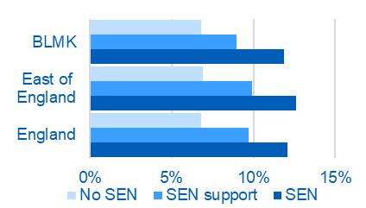
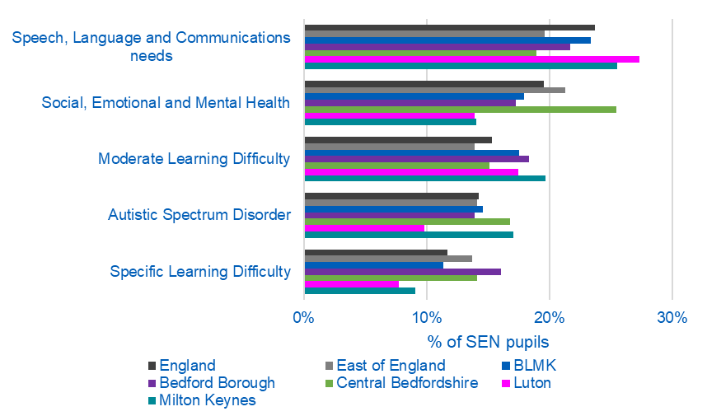
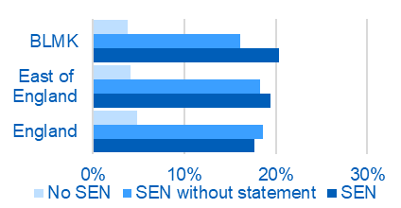
SEND
Context
Among other groups, children with SEN experience disproportionate exclusion from schools. [11]
Absences are defined as the percentage of sessions missed due to overall absence from schools.
Fixed period exclusion refers to a pupil who is excluded from a school for a set period of time. The rate of fixed term exclusions is calculated by taking the number of fixed term exclusions for pupils and dividing it by the total number of pupils.
All pupils with SEN have an assessment of their primary need. The top five of which are shown here.
Attendance
Top 5 primary needs among SEN pupils
For pupils with a SEN statement/EHC plan, 1 in 8 (11.9%) of lessons were missed due to overall absence in BLMK.
This compares to 12.6% for the East of England and 12.1% nationally.
Summary
Lessons missed due to overall absence are highest among SEN pupils with a statement or EHC plan. In BLMK, Central Bedfordshire had the highest rate at 13%.
The percentage of fixed period exclusions for SEN pupils was higher in BLMK than for the East of England and nationally. This was highest in Milton Keynes (30.5%) and lowest in Luton (9.6%).
Some large differences exist between BLMK places for the proportion of pupils by their primary need.
Not shown are the proportion of pupils with SEN support but no specialist assessment of their primary need. This is 2.9% for BLMK and highest in Luton at 5.2%.
The above chart looks at both EHC plan and SEN support pupils combined.
The most common need among BLMK SEN pupils was for speech, language and communication (23%). This was higher in Luton (27%) and Milton Keynes (25%).
Autistic spectrum disorder accounts for 15% of primary needs for BLMK. Luton had the lowest prevalence (10%) among BLMK.
For pupils with a SEN statement/EHC plan, 1 in 5 (20.3%) pupils with SEN had fixed period exclusions in BLMK.
This compares to 19.5% for the East of England and 17.6% nationally.

Slide 14
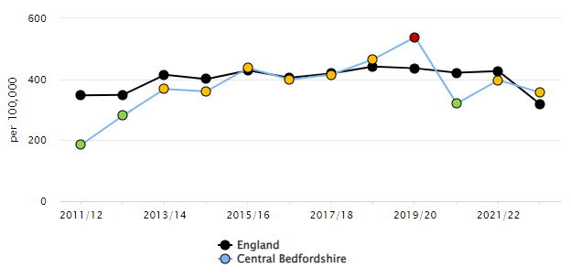
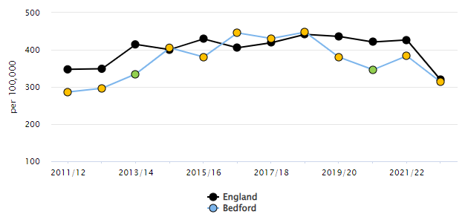
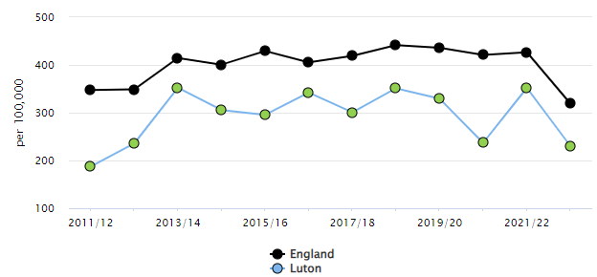
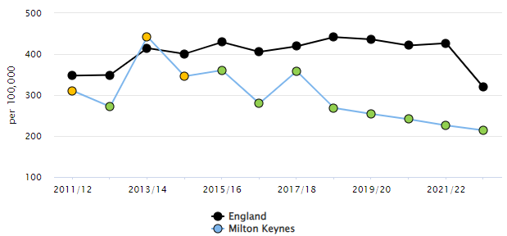
Mental health
7
The rate of hospital admissions as a result of self-harm (10-24 years) is significantly lower than the England average in Luton and Milton Keynes

Slide 15
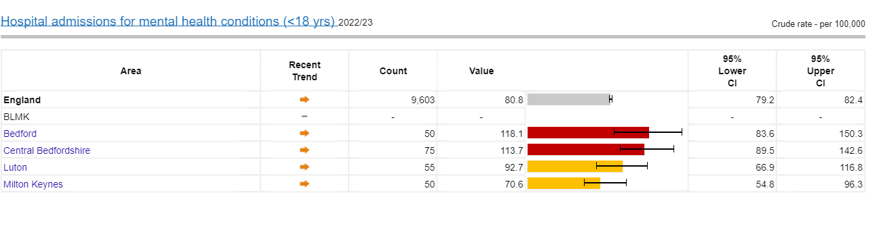
Hospital admissions for MH
Inpatient admission rate for mental health disorders in children and young people aged under 18 is significantly higher than the England average in Bedford and Central Bedfordshire

Slide 16
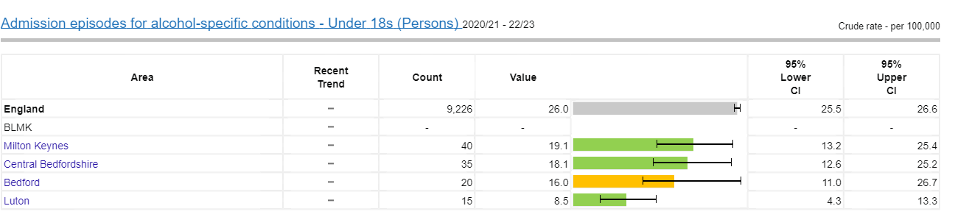
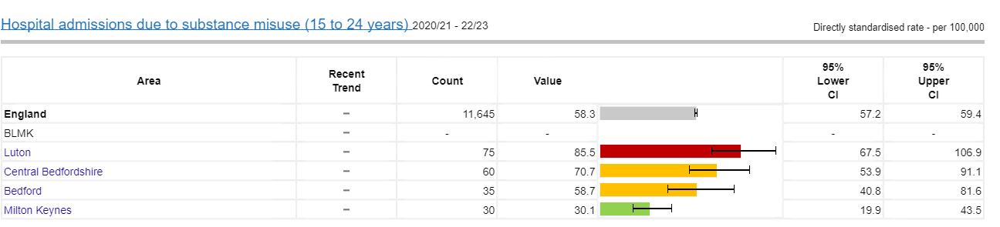
Hospital admissions for drugs and alcohol
The rate of hospital admissions due to substance misuse in 15-24 year olds is significantly higher in Luton than the national average.

Slide 17
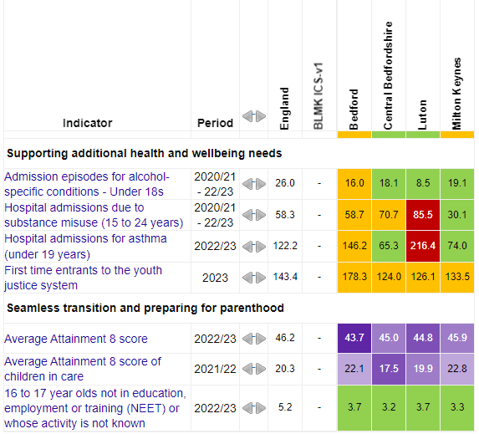
Educational attainment
8
National data show that there is an attainment gap between children eligible for free school meals and their peers who are not eligible.
This is the case within each ethnic group.
Children in care perform less well than their peers, with their Attainment 8 score being less than half of that in the overall pupil population.
Children eligible for free school meals have higher absence from school than their peers.
Pupil absence also varies by ethnicity.

Slide 18
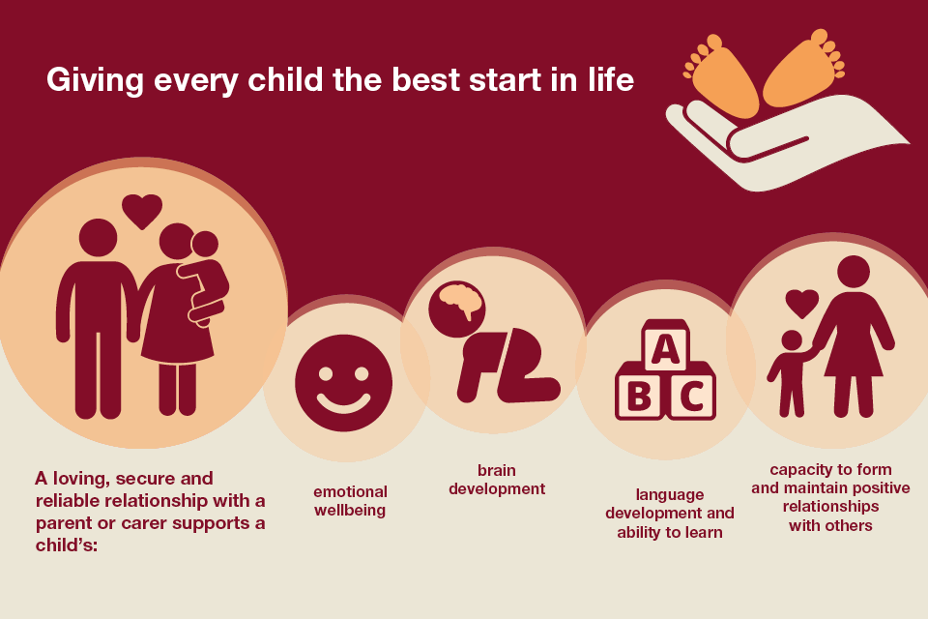
Summary
Data clearly shows there are many opportunities to intervene earlier in a child’s life to ensure that our children have the best start in life and can thrive’
7
Source: https://www.gov.uk/government/publications/health-matters-giving-every-child-the-best-start-in-life/health-matters-giving-every-child-the-best-start-in-life

Slide 19
Appendix

Slide 20
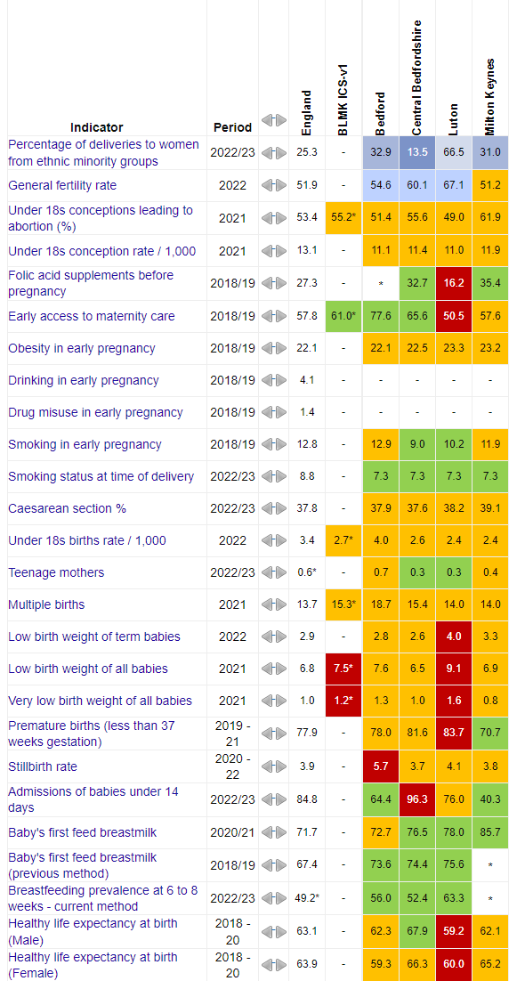
Pregnancy and Births profile

Slide 21
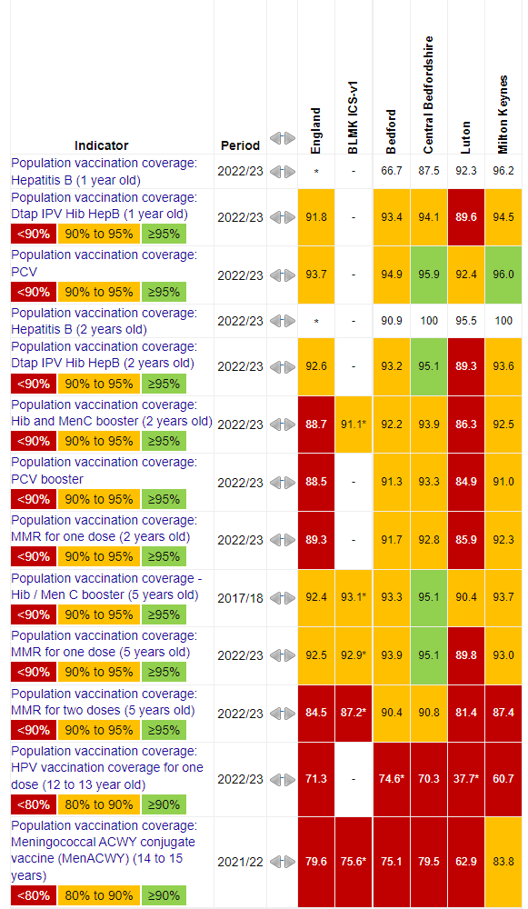
Vaccines and immunisations

Slide 22
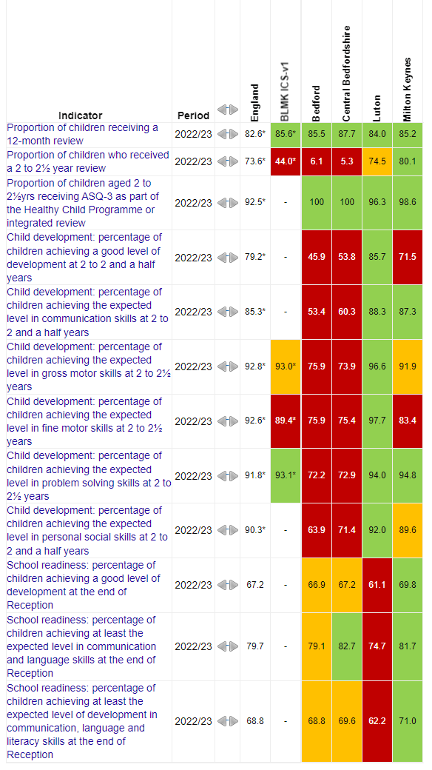
School Readiness

Slide 23
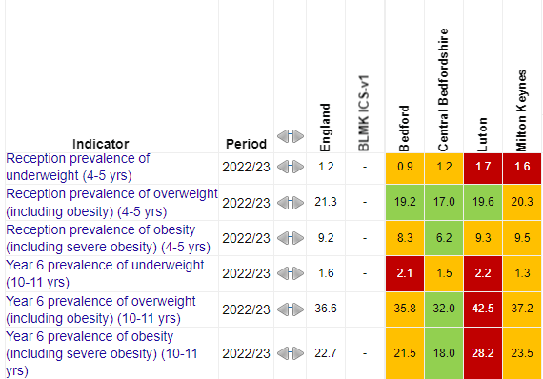
Overweight & Obesity

Slide 24
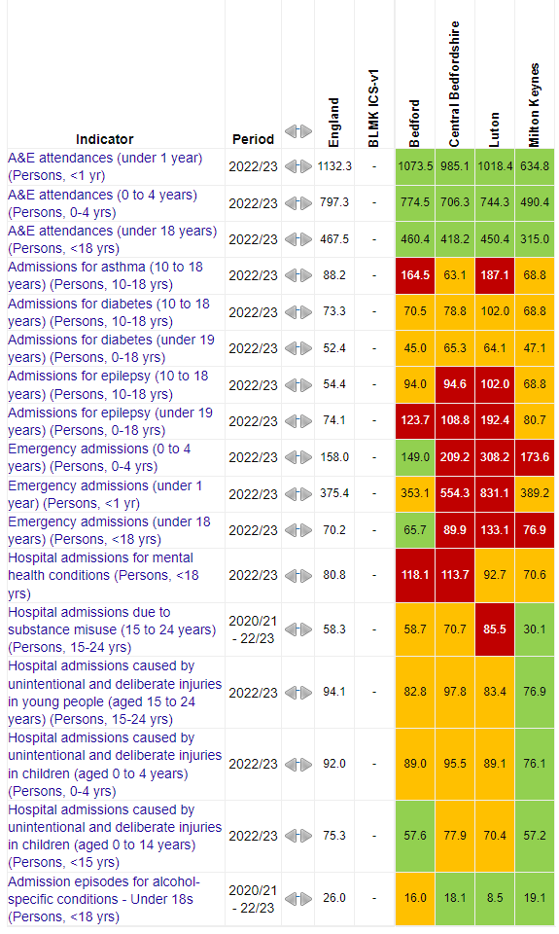
Hospital admissions in CYP population

Slide 25
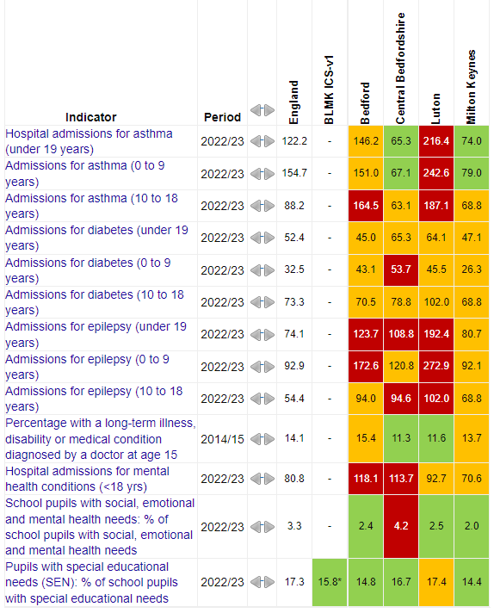
Long term conditions and Complex health needs

Slide 26
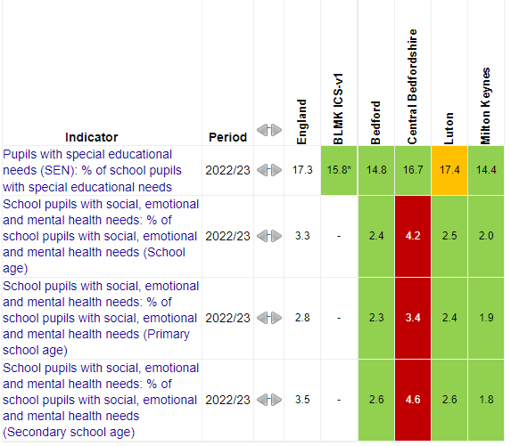
SEND

Slide 27
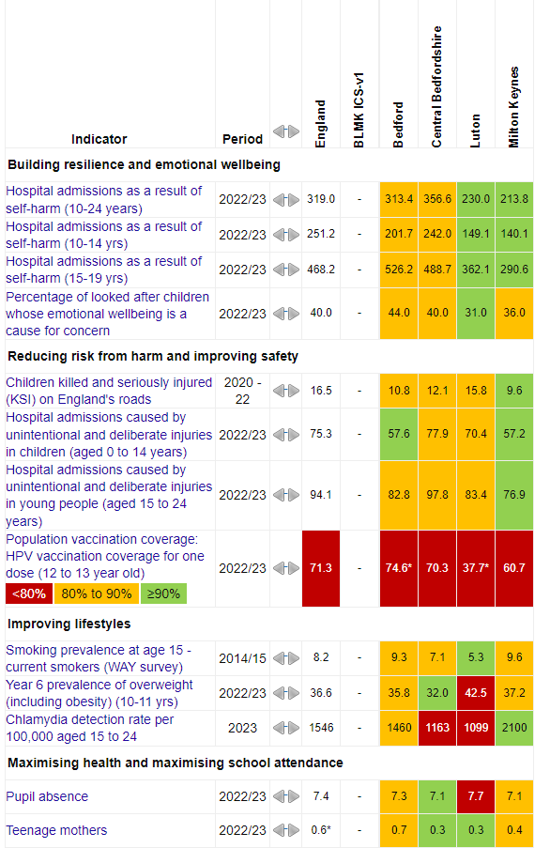
BLMK ICB – High impact areas of Young people

Slide 28
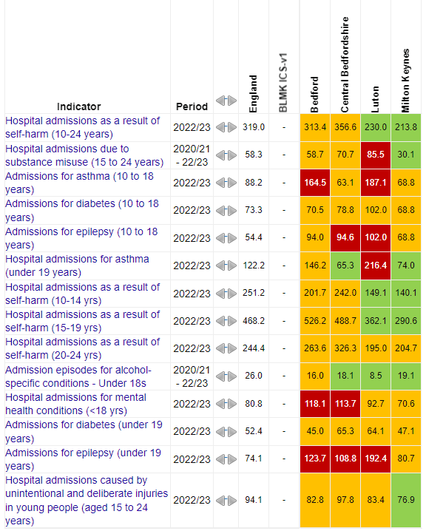
BLMK ICB – Young people

Slide 29
NHS England Population insight Dashboard

Slide 30
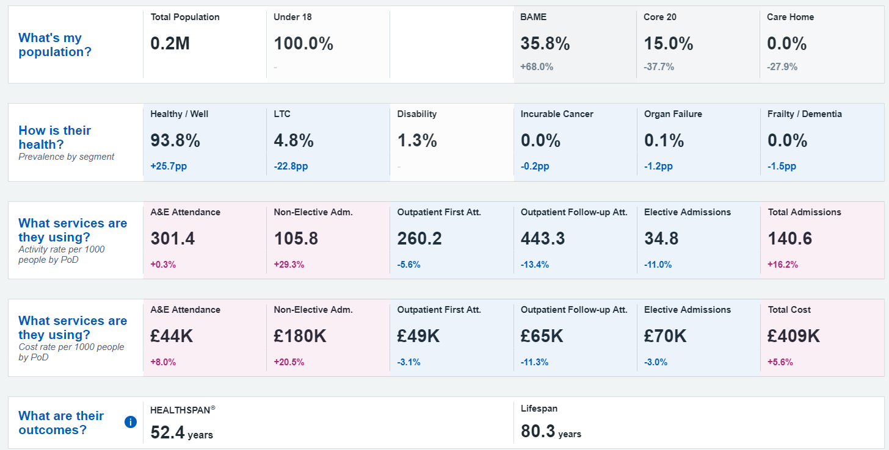
BLMK – CYP (0-17years) overview

Slide 31
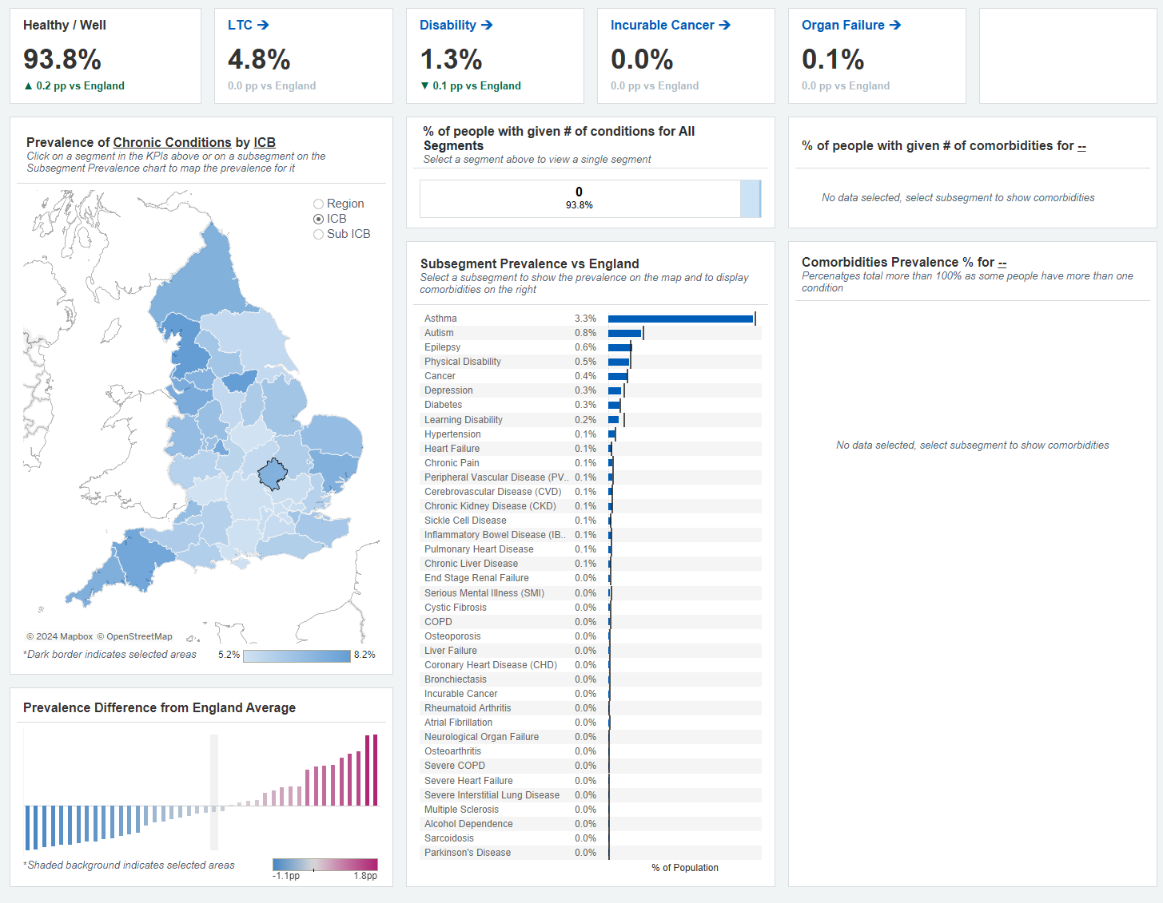
BLMK – CYP
(0-17years) health overview

Slide 32
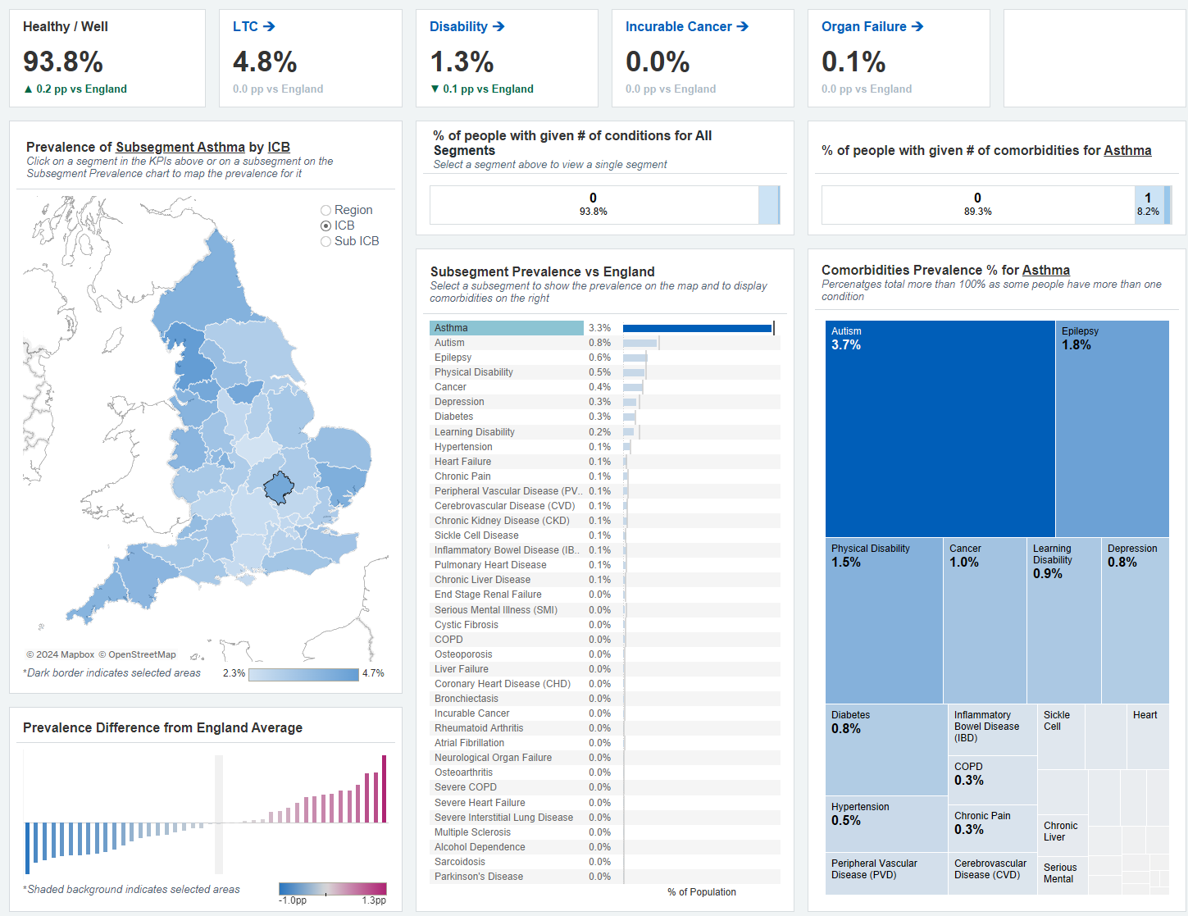
BLMK – CYP
(0-17yrs) Disease prevalence

Slide 33
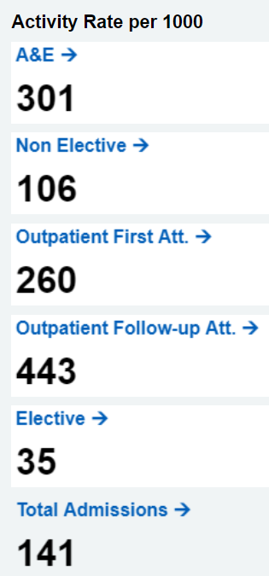
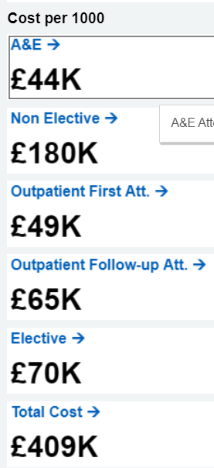
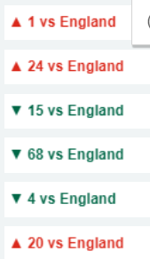
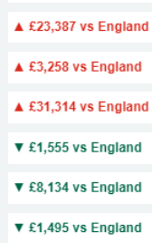
BLMK ICB – Services utilisation & Cost
Activity per 1,000 | Activity rate per 1000 difference from England rate | Cost per 1,000 | Cost per 1000 difference from England rate
Example : BLMK Non-elective admissions 106 per 1,000 ; England 82 per 1000 ; difference from benchmark 24 ( 24 points higher /worse than England average) ;
BLMK A&E attendance cost £43.9k, England A&E cost £40.6k ; BLMK difference from England is £3,258 (higher than England average cost)

Slide 34
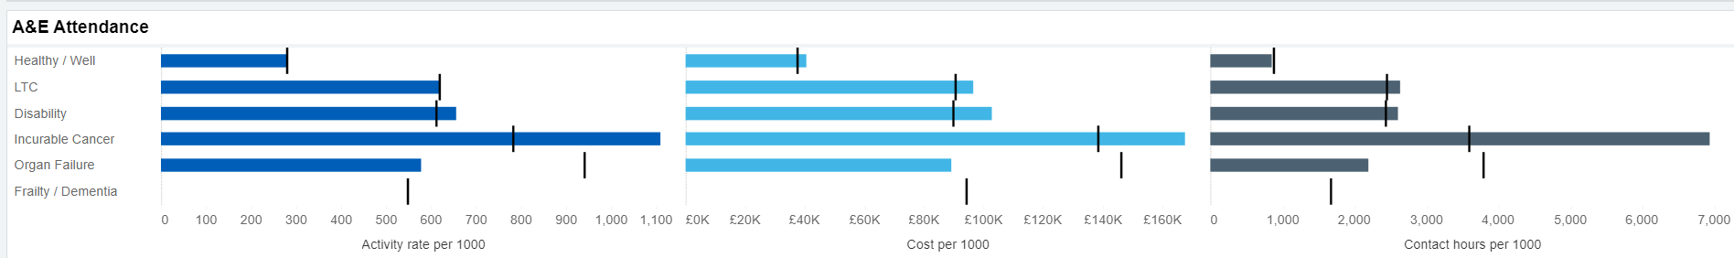
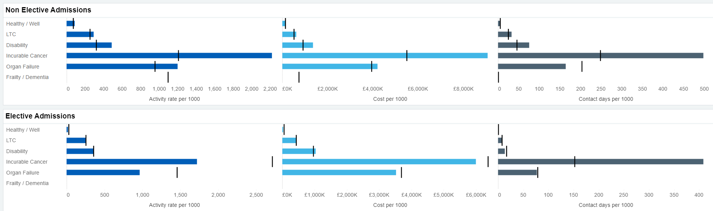
BLMK ICB – services utilisation & cost
Activity per 1,000
Cost per 1,000
Contact hours per 1,000

Slide 35
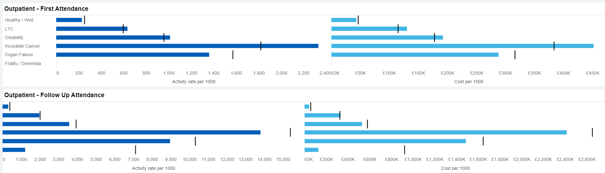
BLMK ICB – Outpatient services utilisation & cost

Slide 36
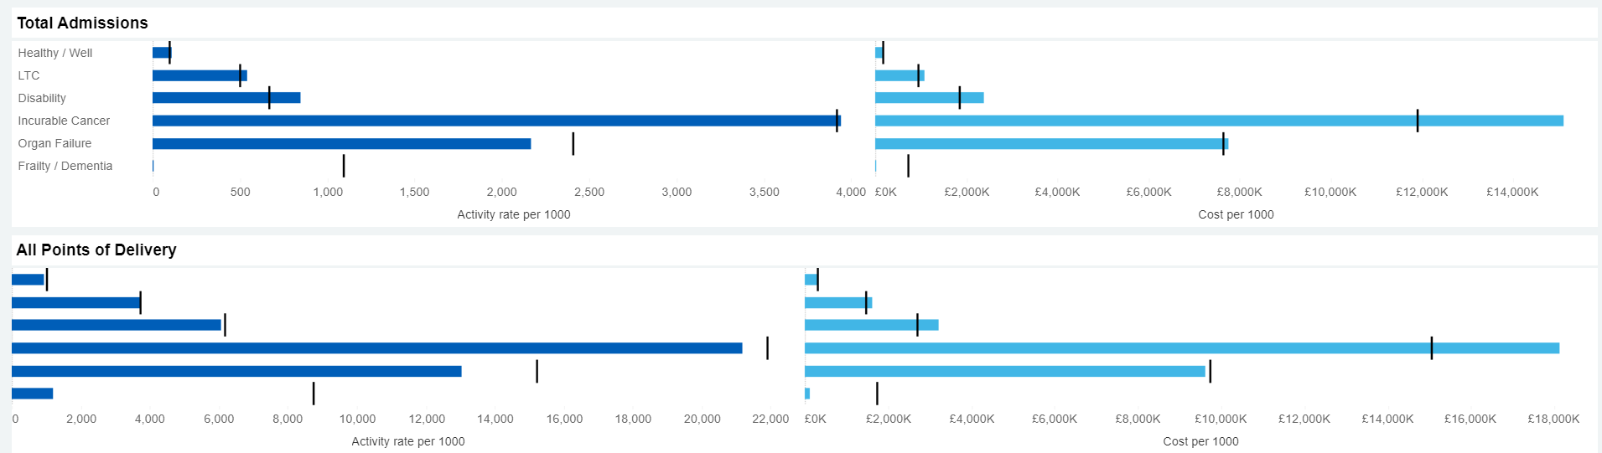
BLMK ICB – services utilisation & cost

