Slide 1
CYP population
BLMK
Produced by the Population Health Intelligence Unit

Slide 2
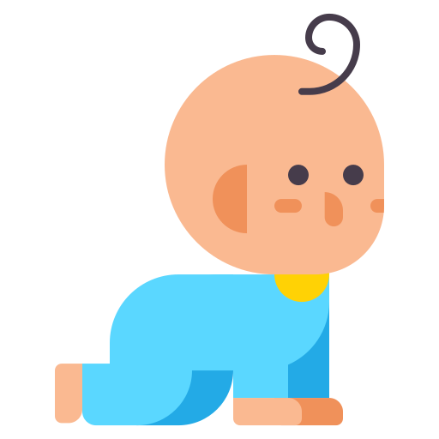




CYP Population in BLMK by age, 2023
65,000 people were 0-4y
244,000 people were under 18 in BLMK
69,000 people were 5-9y
179,000 people were school-aged
(5-17yrs)
110,000 people are were 10-17y
Source: Nomis, mid-2023

Slide 3
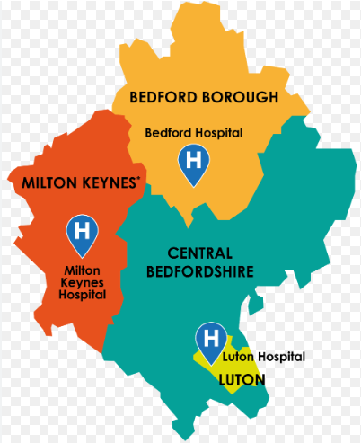
CYP Population in BLMK by place, 2023
Bedford: 43,000
Central Beds: 68,000
244,000 people were under 18 in BLMK
Luton: 60,000
Milton Keynes: 73,000
Source: Nomis, mid-2023
Notes:
Nomis, 2023

Slide 4





CYP characteristics in BLMK
Live births in 2023
Child deaths in 2023
12,310 births took place in BLMK
85 children died before the age of 20y in BLMK
Ethnicity in 2021
Hospital admissions for MH conditions, <18y in 2022/23
Child relative low income in 2022/23
120,000 (39%) of the under 25y are from an ethnic minority group in BLMK.
230 admissions took place in BLMK
36,900 had a relative low income in BLMK
Source: Live births- Nomis, Child deaths- Nomis, Ethnicity- Nomis, MH conditions- Fingertips, Low incomes- Fingertips

Slide 5



Children in need in BLMK
LAC in 2023
BB: 273
CB: 380
Luton: 420
MK: 354
EHCP in 2023: maintained incl foundation schools
EHCP in 2023/24: maintained academy
BB: 401
CB: 564
Luton: 607
MK: 379
BB: 438
CB: 1,154
Luton: 401
MK: 538
Source: LAC- LAIT, EHCP- LG Inform

